Slide 1
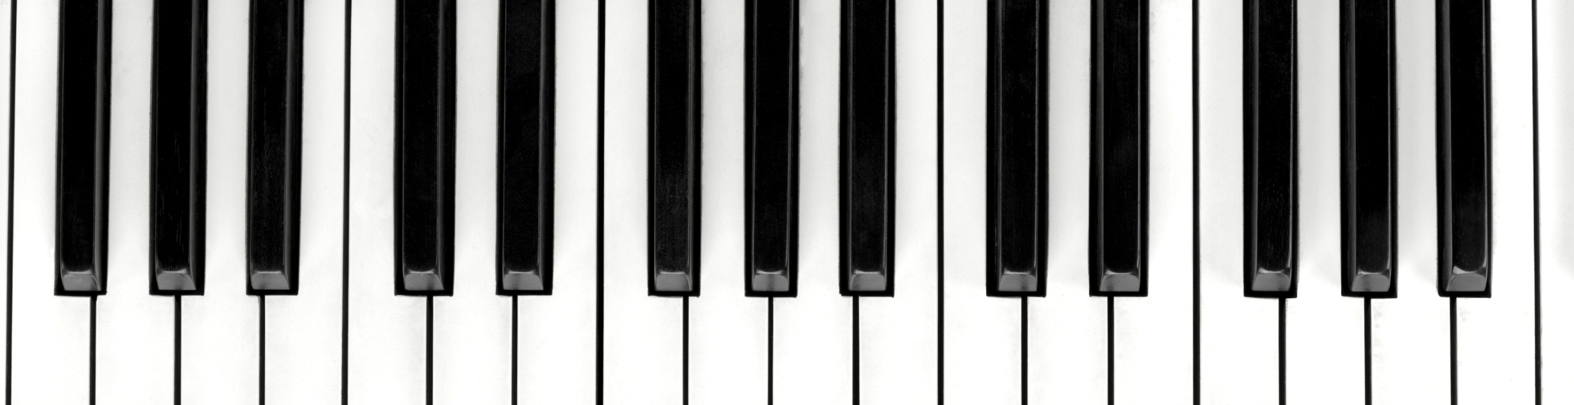
karya Shala-
Sangeet me shastriyta

Slide 2
Moorchana Scale change

Slide 3
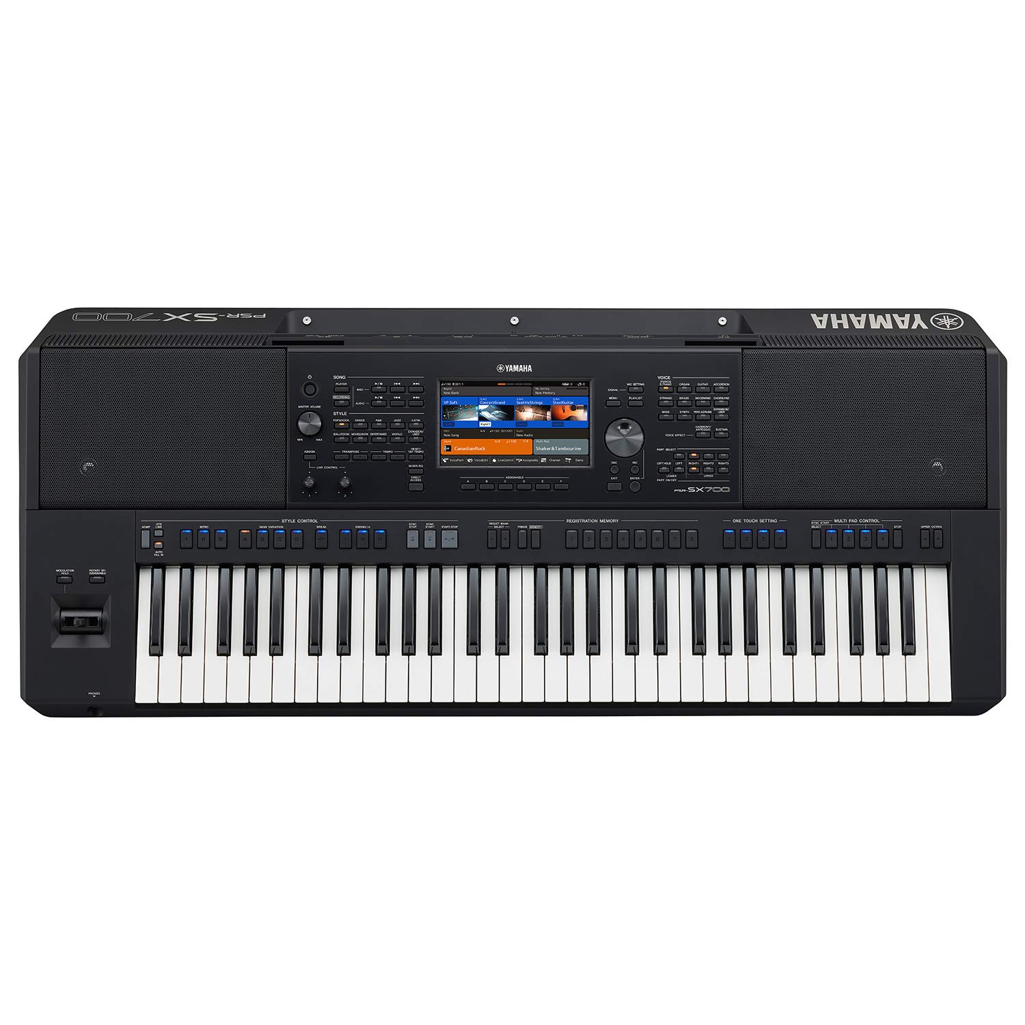
G#/ Kaali4 as Base Note- It gives Raag Bilawal
F#
G#
A#
C#
D#
Sa
Re
Ma
Pa
Sa
Re
Dh
Ni
Ga
Dh
Ni

Slide 4
A#/Kaali 5 as Base Note- It gives Raag Kaafi
F#
G#
A#
C#
D#
Ni
Sa
Ga
Ma
Ni
Sa
Pa
Dh
Re
Pa
Dh

Slide 5
C/Safed 1 as Base Note- it gives Raag ????
F#
G#
A#
C#
D#
Dh
Ni
Re
Ga
Dh
Ni
Sa
Ma
Pa
Sa

Slide 6
C#/Kaali 1 as Base Note- It gives
F#
G#
A#
C#
D#
Pa
Dh
Sa
Re
Pa
Dh
Sa
Ni
Ga
Ḿa
Ni

Slide 7
D#/Kaali 2 as Base Note
F#
G#
A#
C#
D#
Pa
Dh
Sa
Re
Pa
Dh
Sa
Ni
Ga
Ma
Ni

Slide 8
D#/Kaali 2 as Base Note- It gives Raag Khamaj
F#
G#
A#
C#
D#
Ma
Pa
Ni
Sa
Ma
Pa
Ni
Sa
Dh
Re
Ga
Dh

Slide 9
Basic Structure
Take for example, the simplest aaroh-avaroh in all shuddha swaras. It would go:
Sa Re Ga ma Pa Dha Ni Sa"
Sa" Ni Dha Pa ma Ga Re Sa
Now, if you shift your scale one note down and start from Ni instead of Sa, it would go:
Ni' Sa Re Ga ma Pa Dha Ni
Ni Dha Pa ma Ga Re Sa Ni'
In this manner you can keep shifting down one note at a time. Finally, after 8 shifts, you would get:
Sa' Re' Ga' ma' Pa' Dha' Ni' Sa
Sa Ni' Dha' Pa' ma' Ga' Re' Sa
i.e. the same aaroh-avaroh, but in the lower octave instead of the middle octave. Similarly, instead of shifting down one note at a time, you can shift up one note at a time till you reach the upper octave.
Sa" Re" Ga" ma" Pa" Dha" Ni" Sa""
Sa"" Ni" Dha" Pa" ma" Ga" Re" Sa"
This is the basic structure of a Murchhana. (The extent to which you can go up or down will depend on the range of your voice.)

Slide 10
Variation 4
You are no doubt aware that the 12 notes in ICM are not equidistant. The ratio between frequencies of one note and next is not identical. As a result, if your base Sa is shifted, all notes will shift, but not equally, giving you a totally different picture.
To illustrate: If you are singing all shuddha notes, the ratios will be:
Note: Sa Re Ga ma Pa Dha Ni Sa" Re"
Freq: 240 270 300 320 360 405 450 480 540
Ratio: 1/1 9/8 5/4 4/3 3/2 27/16 15/8 2/1 9/4
Now, if you shift Sa one note up to Re, the new ratios will be:
Note: Sa Re Ga ma Pa Dha Ni Sa"
Freq: 270 300 320 360 405 450 480 540
Ratio: 1/1 10/9 32/27 4/3 3/2 5/3 16/9 2/1
As you can see, the frequencies are the same but the ratios (compared to new Sa) are totally different. Therefore, the notes will no longer be shuddha notes (compared to the new frequency).
The new shuddha Re will sound between old komal Re and old shuddha Re, the new shuddha Ga will be lower than old komal Ga, etc. This gives rise to the various shrutis of ICM.
Thus, mastering this enables you to master shrutis.

Slide 11
G#/ Kaali4 as Base Note- It gives MD Sarang
F#
G#
A#
C#
D#
Sa
Re
Ma
Pa
Ni
Sa
Re

Slide 12
A#/ Kaali5 as Base Note- It gives Raag Malkauns
F#
G#
A#
C#
D#
Ni
Sa
Ga
Ma
Dh
Ni
Sa

Slide 13
C#/ Kaali1 as Base Note- It gives Raag Malkauns
F#
G#
A#
C#
D#
Pa
Dh
Sa
Re
Ma
Pa
Dh
Sa

Slide 14
D#/ Kaali2 as Base Note- It gives Raag Bhimpalasi
F#
G#
A#
C#
D#
Ma
Pa
Ni
Sa
Ga
Ma
Pa
Ni
Sa

Slide 15
F#/ Kaali3 as Base Note- It gives Raag Bhoopali
F#
G#
A#
C#
D#
Sa
Re
Ga
Pa
Dh
Sa
Re
Ga
Pa
Dh

